Slide 1
Archaeology
Dr Ashrafuzzaman Khan

Slide 2
Definitions
Archaeology is the scholarly discipline that involves the systematic study of the human past through the recovery, analysis, and interpretation of material culture and environmental data. It is a multidisciplinary field that combines elements of anthropology, history, art history, geology, chemistry, and other sciences to reconstruct and understand past human societies and their cultural development.

Slide 3
Cont…
Archaeology is a multidisciplinary field of study that systematically investigates and interprets the material remains of past human cultures. Through the excavation, analysis, and contextualization of artifacts, structures, and environmental data, archaeologists aim to reconstruct and understand the development, behaviors, and lifestyles of ancient societies, contributing to a comprehensive understanding of human history and cultural evolution. The discipline employs a range of scientific methodologies, including dating techniques, stratigraphy, and interdisciplinary collaboration, to uncover and analyze the physical traces of human activity, providing insights into the complexities of past civilizations. Additionally, ethical considerations, such as site preservation and engagement with descendant communities, are integral components of archaeological practice.

Slide 4
Cont…
Material Culture:
Archaeology focuses on the study of material culture, which includes artifacts, structures, tools, pottery, art, and other physical remains left behind by past human societies. These material remnants are used as primary sources for reconstructing and interpreting the past.
Excavation and Fieldwork:
Archaeologists engage in fieldwork, including excavation and surveying, to uncover and document archaeological sites. Excavations involve the careful removal of layers of soil and sediment to expose artifacts and features in their original context.

Slide 5
Cont…
Chronology and Dating Methods:
Establishing chronology is a fundamental aspect of archaeology. Researchers use various dating methods, such as radiocarbon dating, dendrochronology, and stratigraphy, to determine the age of artifacts and archaeological deposits.
Cultural Context:
Archaeologists consider the cultural context of finds, taking into account the broader cultural, social, economic, and environmental factors that shaped past human societies. This contextual understanding helps in interpreting the significance of artifacts and features.

Slide 6
Cont…
Interdisciplinary Approach:
Archaeology is inherently interdisciplinary, drawing on methods and theories from diverse fields to address complex questions about the past. Collaboration with experts in geology, chemistry, biology, and other disciplines is common.
Site Preservation and Ethics:
Archaeologists are committed to the responsible and ethical practice of their discipline. This includes considerations for site preservation, respectful engagement with local communities, and ethical treatment of human remains and cultural artifacts.
Cultural Heritage Management:
Archaeologists often contribute to cultural heritage management, working to protect and preserve archaeological sites and artifacts for future generations. This involves addressing issues such as looting, site degradation, and the impact of development projects.

Slide 7
Cont…
Historical Reconstruction:
Through the analysis of archaeological evidence, archaeologists contribute to the reconstruction of past human lifeways, social structures, economic systems, technological developments, and cultural practices.
Theory and Interpretation:
Archaeology encompasses various theoretical approaches, including processual archaeology, post-processual archaeology, and more recent developments. These theoretical frameworks guide the interpretation of archaeological data and contribute to broader discussions about human behavior and societal change.

Slide 8
Cont…
Public Engagement and Education:
Many archaeologists emphasize the importance of public engagement and education. Communicating archaeological findings to the public fosters a greater understanding of the past and its relevance to contemporary societies.
These elements collectively define archaeology as a dynamic and evolving discipline that seeks to uncover, understand, and interpret the rich tapestry of human history.

Slide 9
Significance of studying archaeology
Scholarly discussions about the importance of studying archaeology emphasize the multifaceted contributions this discipline makes to our understanding of the past and its relevance to contemporary society. Here are key points from scholarly perspectives:
Reconstruction of Human History:
Archaeology provides a unique window into the human past, allowing scholars to reconstruct the history of different cultures and societies. By studying artifacts, structures, and environmental data, archaeologists contribute to our understanding of the development and evolution of human civilizations.

Slide 10
Cont…
Cultural Understanding and Diversity:
Archaeology helps in preserving and understanding cultural diversity. The study of past cultures allows us to appreciate the richness of human societies and the various ways in which different groups have adapted to their environments and expressed their identities through material culture.
Uncovering Technological Advancements:
Archaeological research reveals technological advancements and innovations in different periods of history. Understanding how past societies developed and used technology can provide insights into the progression of human knowledge and the factors that drove technological change.

Slide 11
Cont…
Insights into Economic Systems:
Archaeology contributes to our understanding of past economic systems and subsistence strategies. By studying tools, trade networks, and agricultural practices, archaeologists can reconstruct how different societies obtained and distributed resources, providing valuable insights into economic structures.
Environmental Change and Adaptation:
The study of archaeological sites includes analyzing environmental data. This allows archaeologists to explore how past societies interacted with their environments, adapted to climate change, and managed natural resources, providing lessons for contemporary environmental challenges.

Slide 12
Cont…
Understanding Social Structures:
Archaeology sheds light on social structures, hierarchies, and interpersonal relationships in ancient societies. By studying burial practices, architecture, and artifacts, scholars can infer information about social organization, gender roles, and power dynamics.
Preservation of Cultural Heritage:
Archaeology plays a crucial role in the preservation of cultural heritage. It involves the responsible management and conservation of archaeological sites and artifacts, ensuring that they are protected for future generations and that their significance is not lost.

Slide 13
Cont…
Contributions to Anthropological Knowledge:
Archaeology is a key subfield of anthropology, contributing to our broader understanding of human societies and cultures. It complements other branches of anthropology, such as cultural anthropology and biological anthropology, by providing a tangible and material dimension to the study of humanity.
Informing Contemporary Issues:
Insights gained from archaeological research can inform contemporary issues, such as urbanization, migration, and globalization. By understanding how past societies navigated similar challenges, archaeology can provide valuable perspectives for addressing current societal issues.

Slide 14
Cont…
Educational and Outreach Opportunities:
Archaeology engages the public in the study of the past, fostering a sense of connection to history and cultural heritage. Educational programs and public outreach initiatives led by archaeologists contribute to a more informed and culturally aware society.
In summary, the importance of studying archaeology lies in its ability to uncover, interpret, and communicate the stories of human societies throughout time, providing valuable insights into our shared heritage and contributing to a deeper understanding of the complexities of the human experience.

Slide 15
Bangladesh
Archaeological sites in this region comprise various types, including standing monuments, monumental remains, buried archaeological deposits, mud fortified spaces, brick-built remains, scatters of stones and stone made artefacts, embankments, and transported deposits of archaeological materials. They can be dated from c. 7th – 8th century CE to c. 18th – 19th century CE. Often, it is found that the archaeological sites from the early period were reused in the later period without any significant increase in the thickness of the cultural debris. Monuments with intact superstructure are the sites where the superstructures are visible in many cases. These monuments are mostly religious edifices belonging to both Brahmanical and Islamic traditions. Simultaneously, many of the monuments of the contemporary period have lost their superstructure and became buried under the later alluvium. They are exposed after excavation. The complex and spatially varied fluvial depositional environment has played a key part in the preservation and destruction of monuments and monumental remains.

Slide 16
Documents
https://whc.unesco.org/en/tentativelists/6669/

Slide 17
Major Archaeological Sites in Bangladesh
Mahasthangarh:
Mahasthangarh, located in Bogura District, is one of the oldest archaeological sites in Bangladesh. It is believed to be the ancient capital of the Pundra Kingdom and has yielded artifacts dating back to the 3rd century BCE. The site includes the ruins of a citadel, a historic mound, and archaeological remains that have contributed to the understanding of early urbanization in the region.
Bagerhat:
Bagerhat, a UNESCO World Heritage Site, is known for the historic Mosque City of Bagerhat. The site contains the ruins of 60 dome mosques, mausoleums, and other structures built during the 15th century by the Turkish general Ulugh Khan Jahan. The city reflects the architectural and cultural achievements of the medieval period.

Slide 18
Cont…
Mainamati-Lalmai:
The Mainamati archaeological site, near Comilla, includes a range of Buddhist archaeological structures dating from the 7th to 12th centuries. Lalmai is known for its ancient Buddhist viharas, stupas, and relics. The site has revealed important artifacts, sculptures, and inscriptions that provide insights into the region's Buddhist history.
Wari-Bateshwar:
Wari-Bateshwar, located in Narsingdi District, is an ancient archaeological site dating back to the 1st millennium BCE. It has revealed evidence of urbanization, trade, and cultural activities. The site is associated with the ancient Vanga Kingdom and is considered one of the earliest urban centers in the Bengal region.

Slide 19
Cont…
Pandu Rajar Dhibi:
Pandu Rajar Dhibi, situated in the Jamalpur District, is an archaeological site with ancient mounds and structures dating back to the Maurya period (4th to 2nd centuries BCE). It is associated with the legendary King Pandu, and excavations have uncovered artifacts and pottery from different historical periods.
Bangarh:
Bangarh, located in the Rajshahi Division, is an archaeological site with remains dating back to the 6th century BCE. Excavations at Bangarh have revealed ancient pottery, terracotta plaques, and other artifacts, shedding light on the early history of the region.

Slide 20
`Cont…
Halud Vihara:
Halud Vihara, situated in Munshiganj, is a Buddhist archaeological site with a rich history dating back to the 10th century. The site includes a monastery and a number of stupas. The archaeological finds include terracotta plaques and sculptures.
Paharpur Buddhist Vihara:
Location: Naogaon District, northwestern Bangladesh.
Significance: Paharpur is home to one of the largest Buddhist monasteries in South Asia. The site, known as Somapura Mahavihara, dates back to the 8th century and was an important center for Buddhist learning.

Slide 21
Cont…
Bhitargarh:
Location: Comilla District, southeastern Bangladesh.
Significance: Bhitargarh is an archaeological site with remnants of an ancient fort dating back to the 7th century. The site has provided evidence of early Hindu and Buddhist influence in the region.
Lalbagh Fort:
Location: Dhaka, the capital of Bangladesh.
Significance: While Lalbagh Fort is more commonly associated with the Mughal period, it has archaeological importance. Construction of the fort began in the 17th century but was never completed. The site includes a mosque, a mausoleum, and a palace.

Slide 22
Cont…
Chandraketugarh:
Location: Berachampa, near the Bangladeshi-Indian border.
Significance: Chandraketugarh is an archaeological site with evidence of ancient urban planning and artifacts dating back to the Mauryan and Gupta periods. The site reflects a mix of Hindu and Buddhist influences.
Khulnar Dhap:
Location: Khulna District, southwestern Bangladesh.
Significance: Khulnar Dhap is an archaeological site containing evidence of an ancient urban settlement with brick structures. Excavations have revealed artifacts dating back to the 3rd century BCE.
These archaeological sites in Bangladesh contribute to the understanding of the country's cultural and historical development, showcasing the diverse influences that have shaped the region over the centuries. Ongoing research and excavations continue to provide new insights into Bangladesh's rich archaeological heritage.

Slide 23
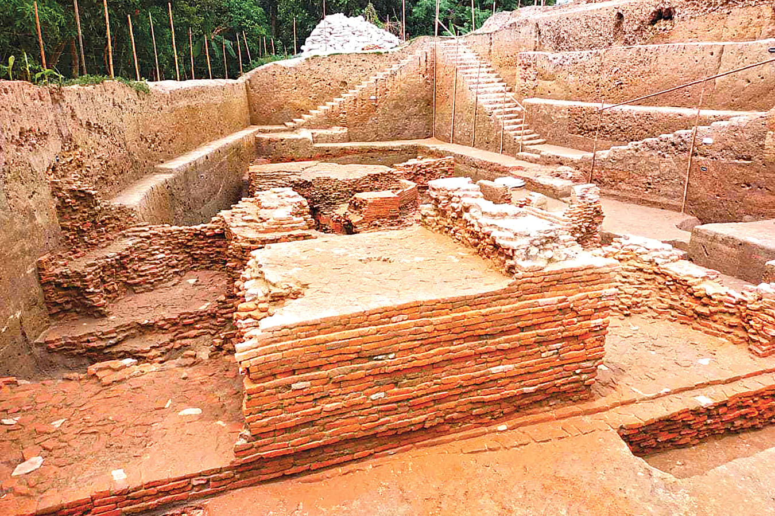
1,100-year-old structure discovered (New archeological site discovered in Nateshwar Deul of Munshiganj, 17 Apr 2022)

Slide 24
Documentaries
https://www.aljazeera.com/features/2018/3/12/new-findings-could-rewrite-bangladeshs-history
https://www.youtube.com/watch?v=AOEjbp2gQ2I

